Slide 1

Senior Analyst Case Study
Anjelica Ramsey

Slide 2
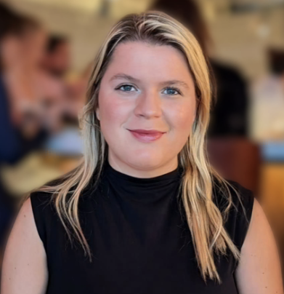


About me
Location: Philadelphia, PA
Current: Contract Data Specialist for pharmaceutical companies, focusing on data aggregation and reporting dashboards
Experience: Worked with stakeholders at MSKCC on emergency room operations strategy and analytics
Education:
Master of Health Administration (MHA), Rutgers University
Data Analytics Certificate, Columbia University
Strengths: Defining business metrics, and creating interactive dashboards
Approach: Collaborative approach, bridging business needs with technical solutions

Slide 3



How I collaborate
Explore
Build
Define
Confirm
Validate
Explore the data with stakeholders to understand workflows and source tables
Clarify data definitions (patients, engagement events, milestones) to align clinical and product perspectives
Confirm data flows through ETL (Extract, Transform, Load) to ensure clean, consistent inputs for analysis
Validate outputs at each step with stakeholders before moving forward
Iterate collaboratively to ensure the final dashboard answers the right questions

Slide 4
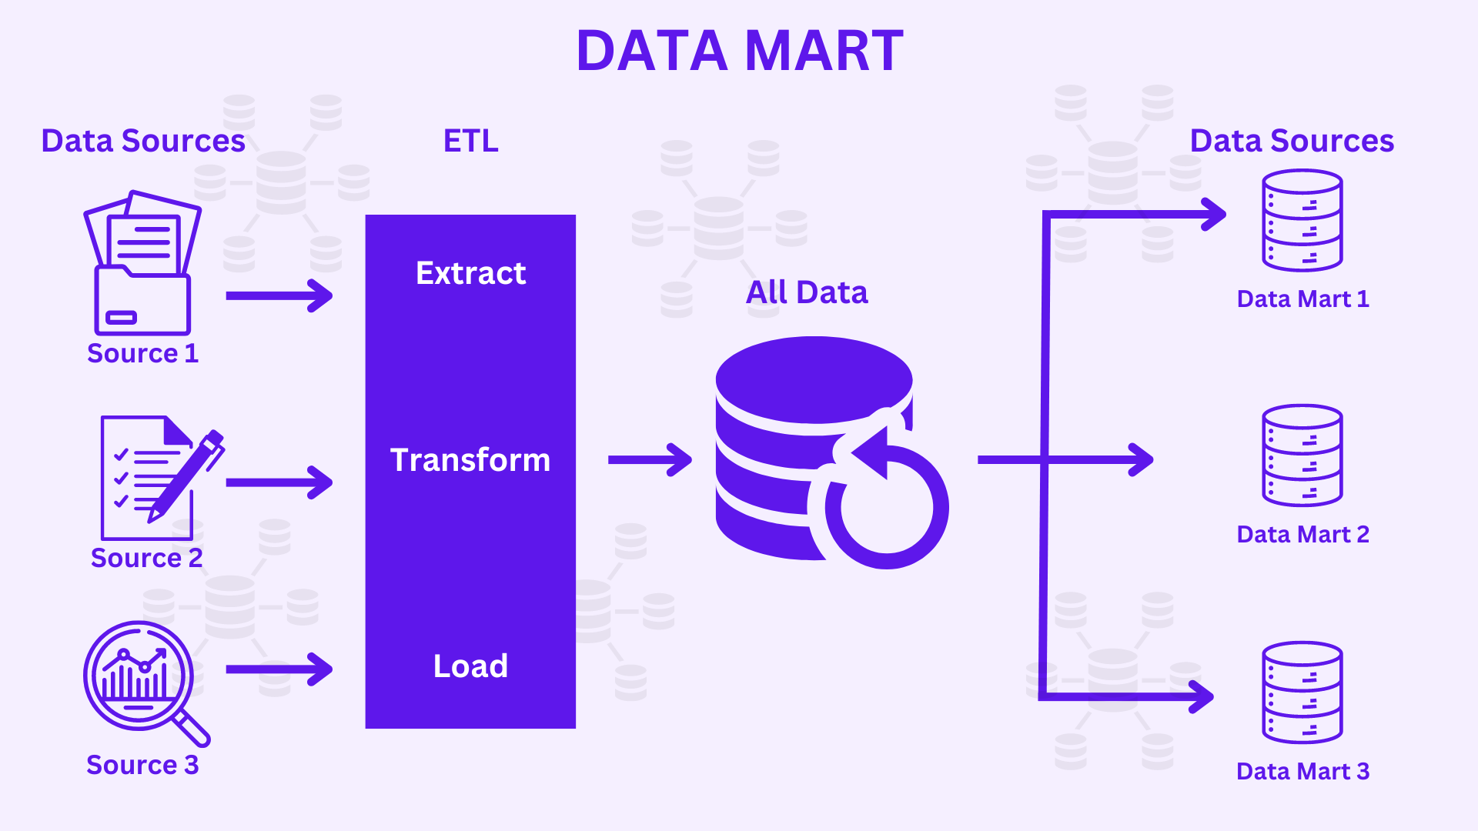
Data Structures
Sources & grain: Staged raw tables (Patients, App Engagement, Email, Text, Phone) at event-level.
Join model: Patient is the hub (key = patient_id); event tables left-join to patient.
Dedup & hygiene: De-duped emails by email_number; normalized booleans
Timestamps: Ingested event datetimes; standardized to a single zone & truncated to day for reporting.
Output tables: Built mart_patient_flat (1 row / patient)

Slide 5
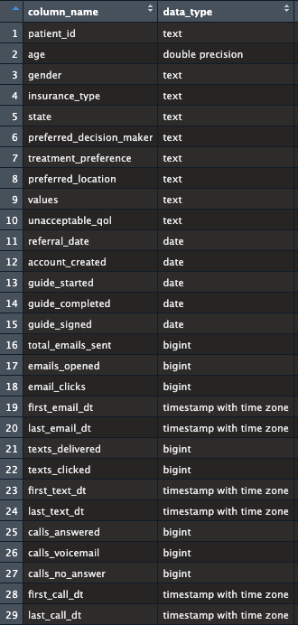

Aggregation and Definitions
Aggregation logic: Aggregate events per patient; preserve min/max event dates.
Quality checks: Row counts, distinct keys, null scans.
Solutions to this data:
Emails: Counted distinct email_number to prevent duplicate logs from inflating totals.
Clicks: Counted only TRUE values so FALSE = 0.
If I had more time: Custom schemas, automated data checks tests, incremental loads, rack patient profile changes over time.
Each patient might have multiple phone calls in a week. In the data mart, I would capture the total number of calls by type so volume isn’t lost, but I would also carry the first and last call dates to track recency. That balance keeps the data usable while avoiding an overly noisy timeline.

Slide 6
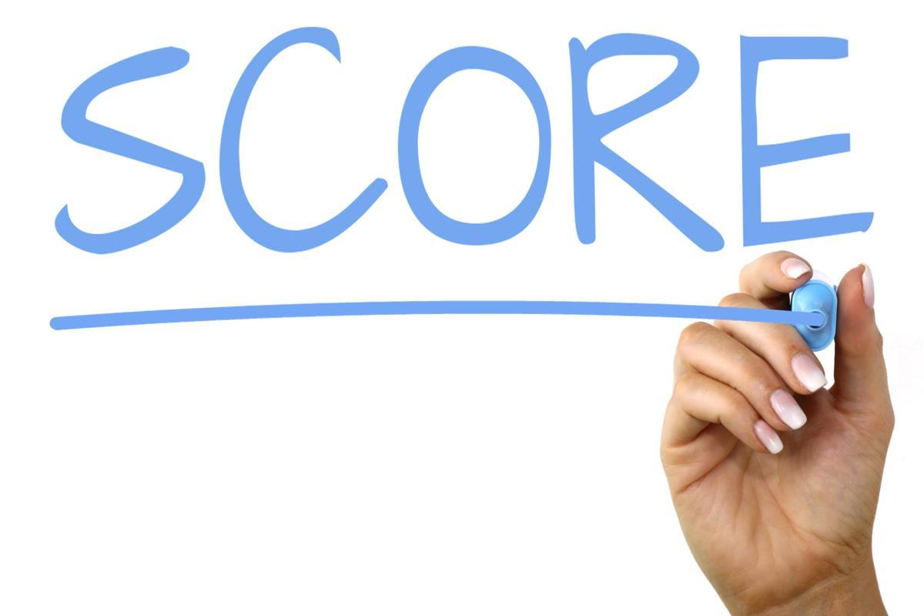
Defining Engagement Score & Tiers
Engagement Score (0–100)
Milestones ≤40 pts (10 each: account created, guide started, guide completed, guide signed)
Clicks ≤30 pts (3 pts per email/text click)
Phone ≤20 pts (4 pts answered call, 1 pt voicemail)
Opens ≤10 pts (1 pt per email open)
Cap: 100 max per patient
Engagement Tiers:
High = ≥40 pts
Medium = 20–39 pts
Low = <20 pts
I would meet with clinicians, nursing, and product leads to discuss what should count as real engagement. Milestones would serve as the strongest indicators, while clicks and calls would act as supporting signals. Opens would reflect awareness only, and tiering patients into High, Medium, and Low would give the team a simple way to segment patients.

Slide 7
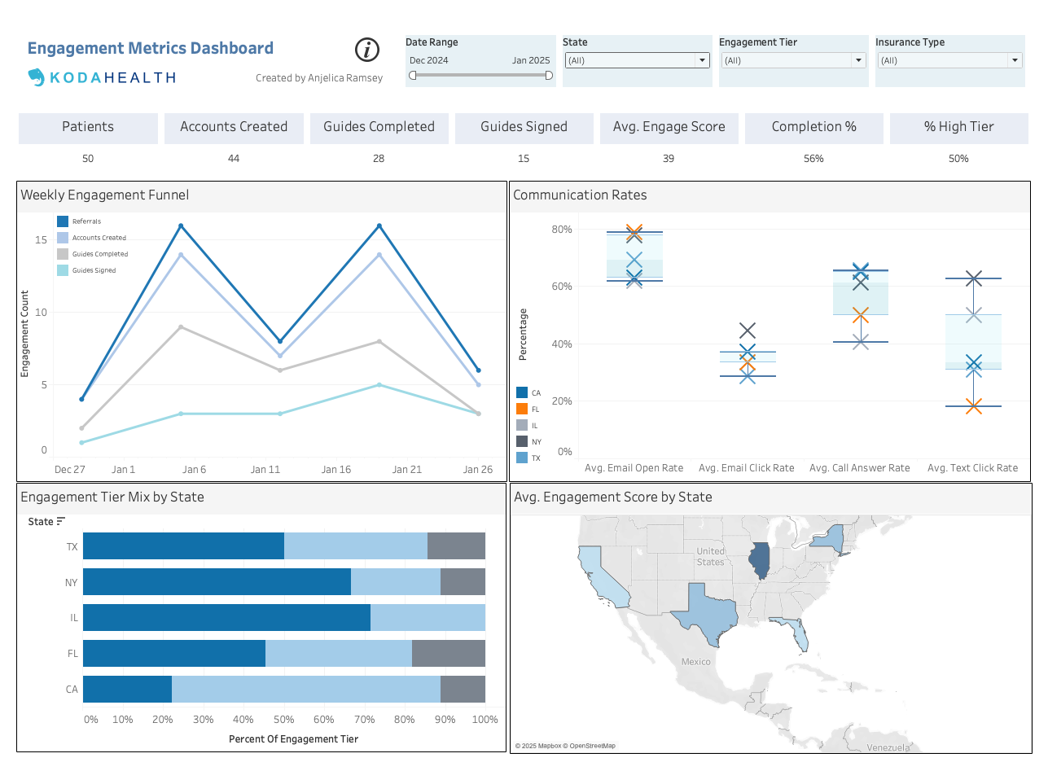

Slide 8
Insights
Engagement fluctuates week to week, with spikes in referrals and account creations around January 1 and January 21, suggesting event-driven patterns.
Email open rates are high (70–80%), but follow-through drops with click rates at 30–35%, call answer rates around 60%, and text click rates at 20–40%.
In most states, fewer than half of patients fall into the “High” engagement tier; California is lowest, while Illinois shows stronger engagement scores.
Overall engagement is modest: the average score is 39 (below the “High” threshold of 40), with only half of patients reaching high engagement and a completion rate of 56%.

